Slide 1
Splay tree data structure

Slide 2
Introduction
Splay tree is a self-adjusting binary search tree data structure, which means that the tree structure is adjusted dynamically based on the accessed or inserted elements. In other words, the tree automatically reorganizes itself so that frequently accessed or inserted elements become closer to the root node.
The splay tree was first introduced by Daniel Dominic Sleator and Robert Endre Tarjan in 1985.
It has a simple and efficient implementation that allows it to perform search, insertion, and deletion operations in O(log n) .
The basic idea behind splay trees is to bring the most recently accessed or inserted element to the root of the tree by performing a sequence of tree rotations, called splaying.
Splaying is a process of restructuring the tree by making the most recently accessed or inserted element the new root and gradually moving the remaining nodes closer to the root.

Slide 3
Introduction
Splay trees are highly efficient in practice due to their self-adjusting nature, which reduces the overall access time for frequently accessed elements. This makes them a good choice for applications that require fast and dynamic data structures, such as caching systems, data compression, and network routing algorithms.
However, the main disadvantage of splay trees is that they do not guarantee a balanced tree structure, which may lead to performance degradation in worst-case scenarios. Also, splay trees are not suitable for applications that require guaranteed worst-case performance, such as real-time systems or safety-critical systems.
Overall, splay trees are a powerful and versatile data structure that offers fast and efficient access to frequently accessed or inserted elements. They are widely used in various applications and provide an excellent tradeoff between performance and simplicity.

Slide 4
Introduction
A splay tree is a self-balancing binary search tree, designed for efficient access to data elements based on their key values.
The key feature of a splay tree is that each time an element is accessed, it is moved to the root of the tree, creating a more balanced structure for subsequent accesses.
Splay trees are characterized by their use of rotations, which are local transformations of the tree that change its shape but preserve the order of the elements.
Rotations are used to bring the accessed element to the root of the tree, and also to rebalance the tree if it becomes unbalanced after multiple accesses.

Slide 5
Operations in a splay tree
Insertion: To insert a new element into the tree, start by performing a regular binary search tree insertion. Then, apply rotations to bring the newly inserted element to the root of the tree.
Deletion: To delete an element from the tree, first locate it using a binary search tree search. Then, if the element has no children, simply remove it. If it has one child, promote that child to its position in the tree. If it has two children, find the successor of the element (the smallest element in its right subtree), swap its key with the element to be deleted, and delete the successor instead.

Slide 6
Operations in a splay tree
Search: To search for an element in the tree, start by performing a binary search tree search. If the element is found, apply rotations to bring it to the root of the tree. If it is not found, apply rotations to the last node visited in the search, which becomes the new root.
Rotation: The rotations used in a splay tree are either a Zig or a Zig-Zig rotation. A Zig rotation is used to bring a node to the root, while a Zig-Zig rotation is used to balance the tree after multiple accesses to elements in the same subtree.

Slide 7
Rotations in Splay Tree
Zig Rotation
Zag Rotation
Zig – Zig Rotation
Zag – Zag Rotation
Zig – Zag Rotation
Zag – Zig Rotation

Slide 8
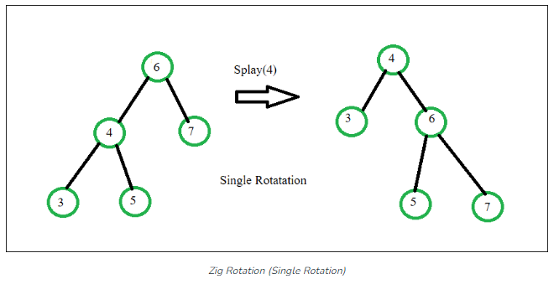
1) Zig Rotation
The Zig Rotation in splay trees operates in a manner similar to the single right rotation in AVL Tree rotations. This rotation results in nodes moving one position to the right from their current location.

Slide 9
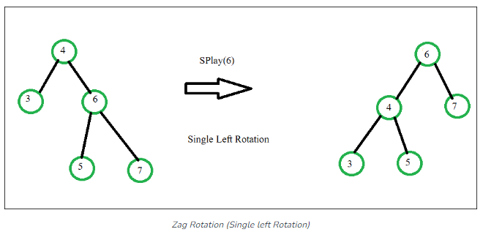
2) Zag Rotation
The Zag Rotation in splay trees operates in a similar fashion to the single left rotation in AVL Tree rotations. During this rotation, nodes shift one position to the left from their current location.

Slide 10
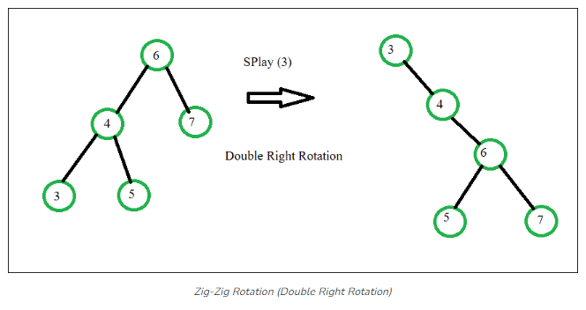
3) Zig-Zig Rotation
The Zig-Zig Rotation in splay trees is a double zig rotation. This rotation results in nodes shifting two positions to the right from their current location.

Slide 11
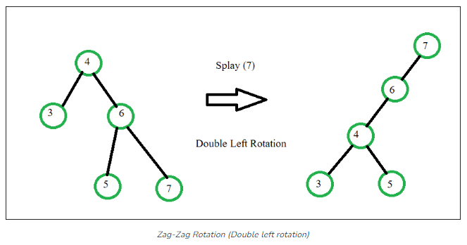
4) Zag-Zag Rotation
In splay trees, the Zag-Zag Rotation is a double zag rotation. This rotation causes nodes to move two positions to the left from their present position

Slide 12
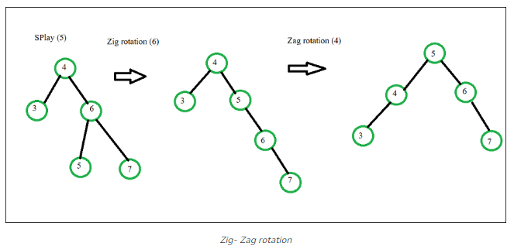
5) Zig-Zag Rotation
The Zig-Zag Rotation in splay trees is a combination of a zig rotation followed by a zag rotation. As a result of this rotation, nodes shift one position to the right and then one position to the left from their current location

Slide 13
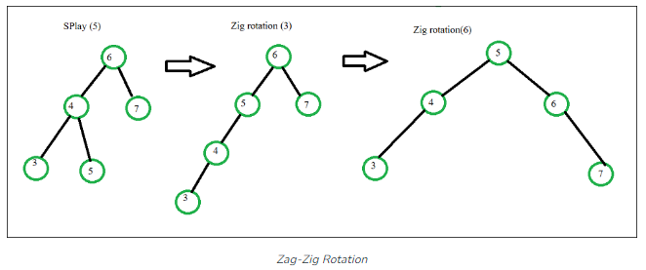
6) Zag-Zig Rotation
The Zag-Zig Rotation in splay trees is a series of zag rotations followed by a zig rotation. This results in nodes moving one position to the left, followed by a shift one position to the right from their current location

Slide 14
Drawbacks of splay tree data structure
Unbalanced Trees: Splay trees can become unbalanced and inefficient if the tree is repeatedly rotated in the same direction.
Memory Usage: Splay trees can use a lot of memory compared to other data structures because each node contains additional information.
Complexity: Splay trees can have a high time complexity for basic operations such as insertion and deletion because the trees need to be reorganized after every operation.
Reorganization Overhead: The splaying operation required in every operation can be time-consuming and result in a high overhead.
Limited Use Cases: Splay trees are not suitable for all data structures and have limited use cases because they don’t handle duplicate keys efficiently.

Slide 15
Applications of the splay tree
Caching: Splay trees can be used to implement cache memory management, where the most frequently accessed items are moved to the top of the tree for quicker access.
Database Indexing: Splay trees can be used to index databases for faster searching and retrieval of data.
File Systems: Splay trees can be used to store file system metadata, such as the allocation table, directory structure, and file attributes.
Data Compression: Splay trees can be used to compress data by identifying and encoding repeating patterns.
Text Processing: Splay trees can be used in text processing applications, such as spell-checkers, where words are stored in a splay tree for quick searching and retrieval.
Graph Algorithms: Splay trees can be used to implement graph algorithms, such as finding the shortest path in a weighted graph.
Online Gaming: Splay trees can be used in online gaming to store and manage high scores, leaderboards, and player statistics.

Slide 16
Advantages of Splay Trees
Splay trees have amortized time complexity of O(log n) for many operations, making them faster than many other balanced tree data structures in some cases.
Splay trees are self-adjusting, meaning that they automatically balance themselves as items are inserted and removed. This can help to avoid the performance degradation that can occur when a tree becomes unbalanced.

Slide 17
Disadvantages of Splay Trees
Splay trees can have worst-case time complexity of O(n) for some operations, making them less predictable than other balanced tree data structures like AVL trees or red-black trees.
Splay trees may not be suitable for certain applications where predictable performance is required

